Slide 1
MSE 312: MECHATRONICS DESIGN II Electronics/Control Lab 1 Introduction to Simscape Electrical
Sepehr Rezvani | 301291960
Arash Pour-zargar | 301123105
Chad Graham | 301308419
Darwin Chang | 301315054

Slide 2
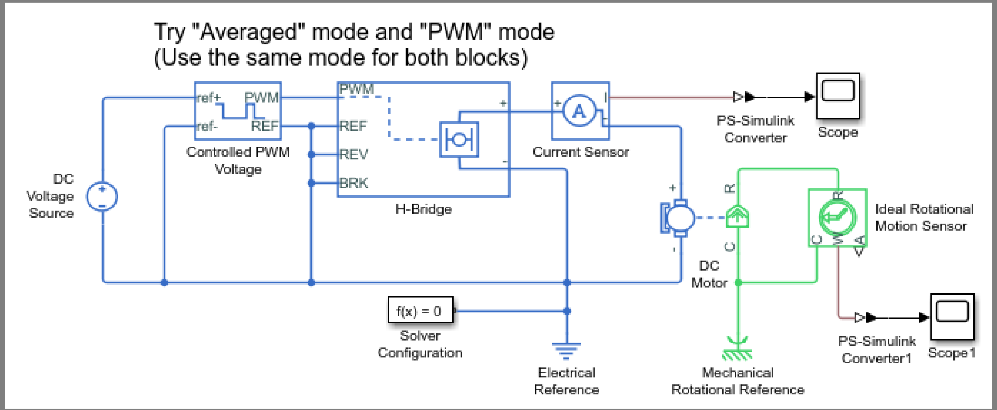
PART B: CREATING A SIMPLE DC MOTOR MODEL
Overall DC Motor Layout
This picture was replicated in Simscape Electrical

Slide 3
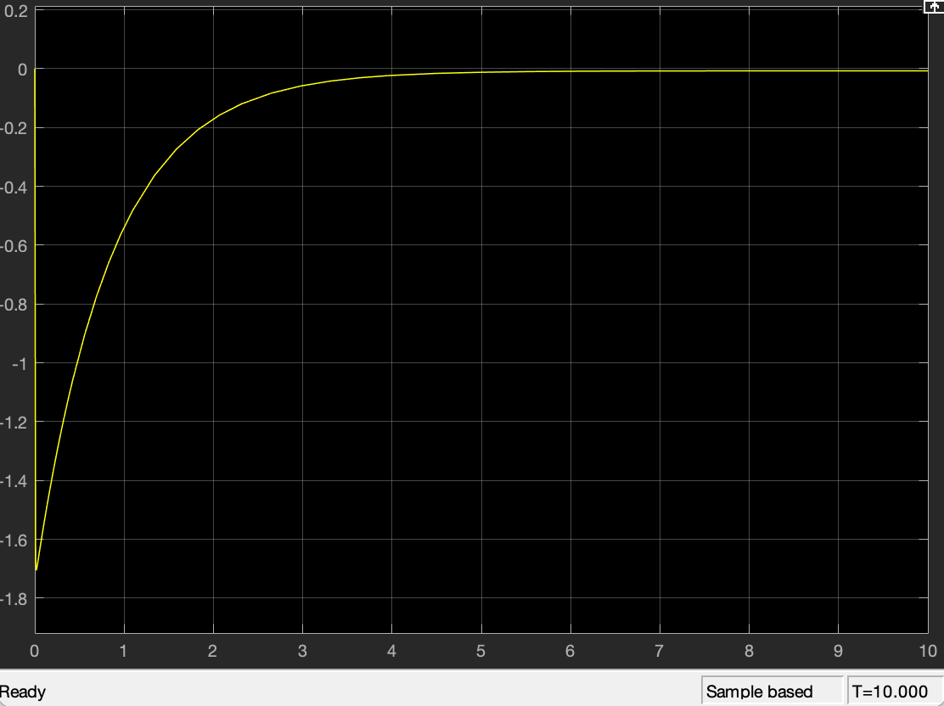
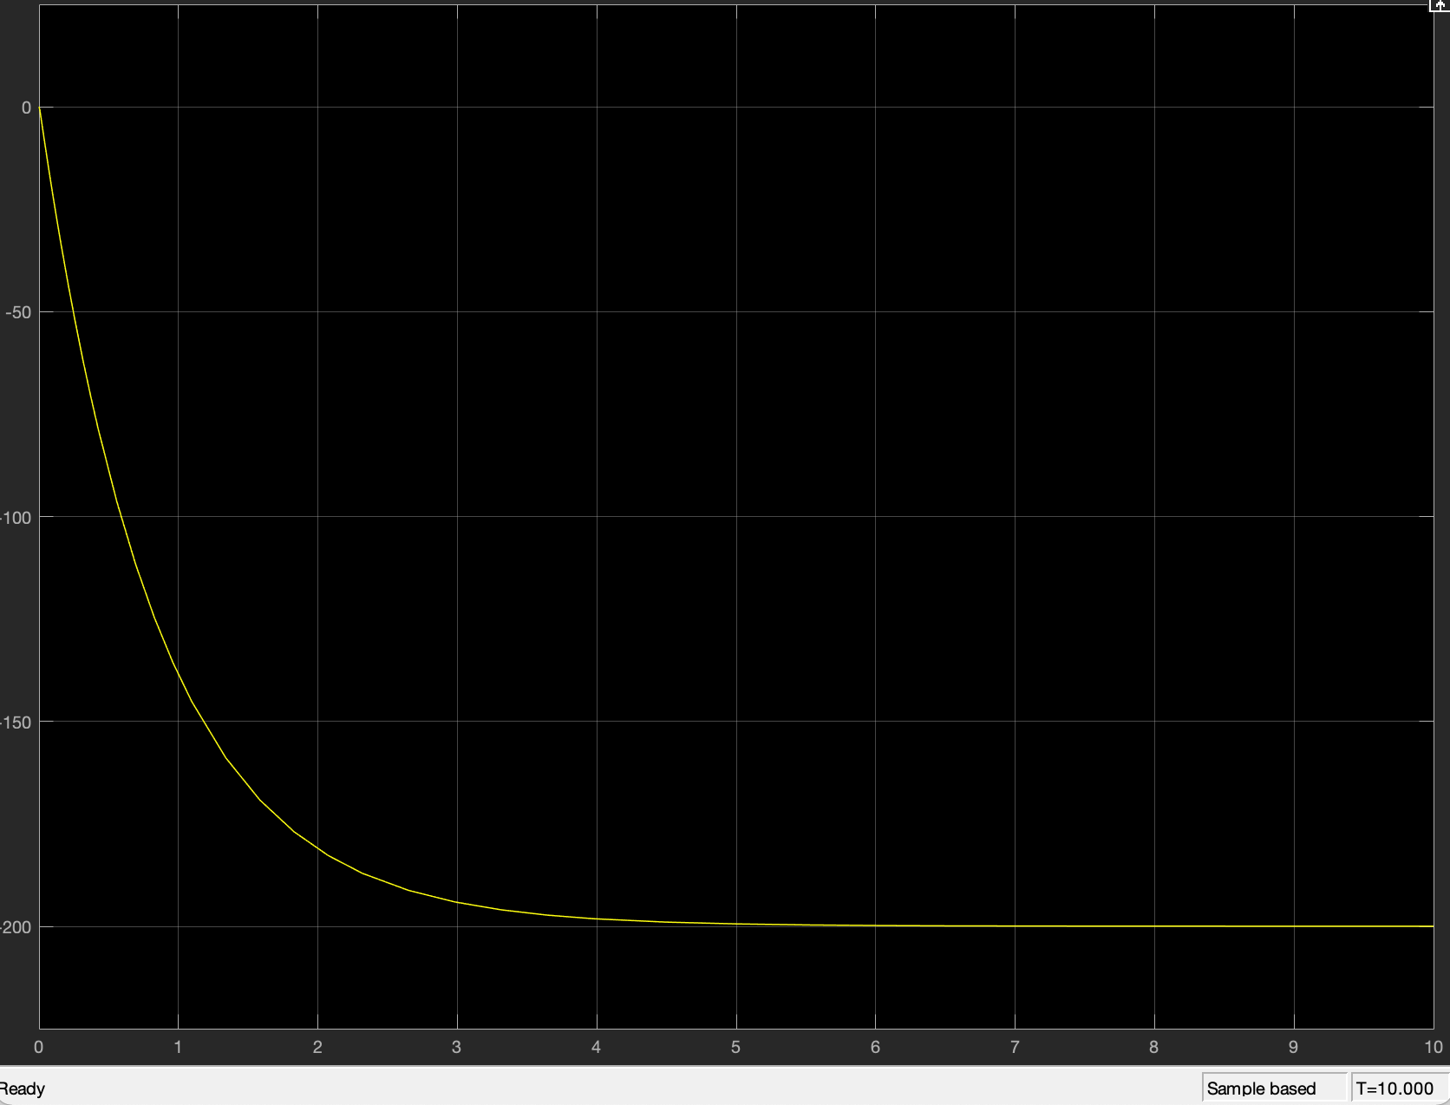
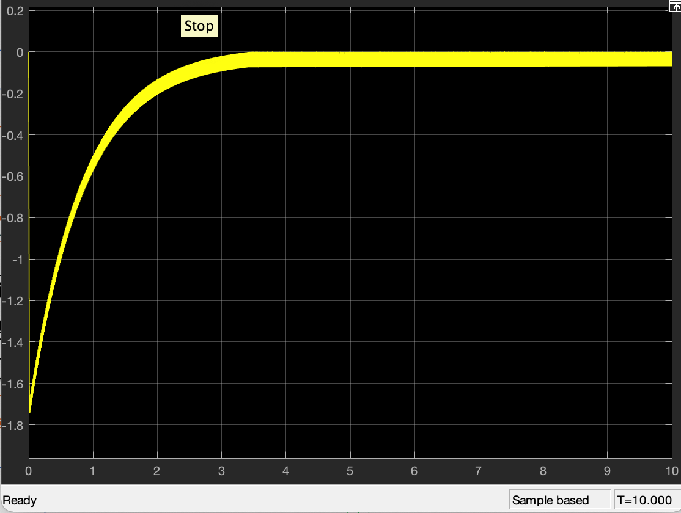
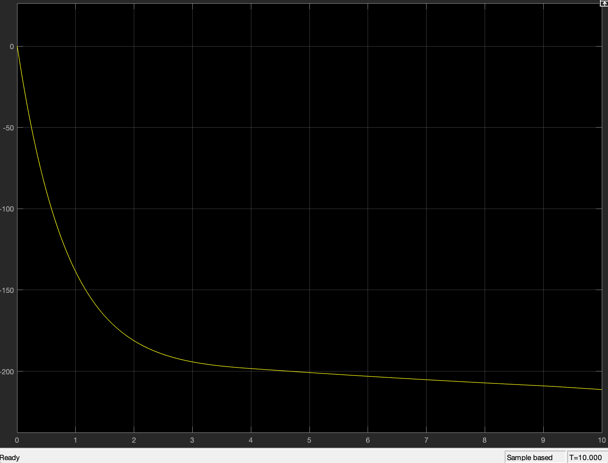
^{PART B Results}
 | Left | Right
Top | Averaged Current | Averaged RPM
Bottom | PWM Current | PWM RPM

Slide 4
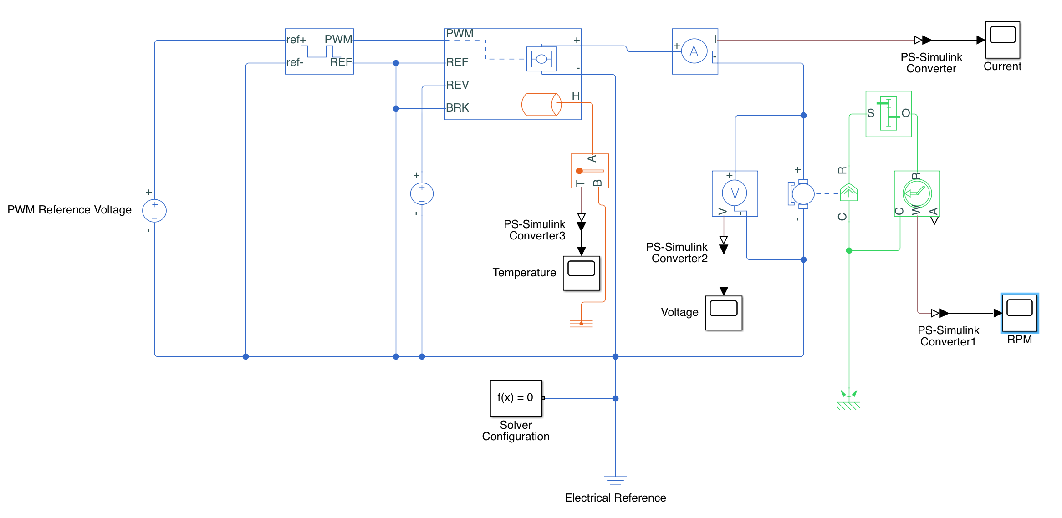
^{ACTIVITY FOR LAB 1}

Slide 5
^{ACTIVITY FOR LAB 1}
As seen on the previous page, this design is similar and based on Part B Simscape design
Here are some additional components added and their purpose:
Thermal Port: The Orange section on the H-bridge → To monitor temperature of H-bridge as current goes through.
Temperature sensor → connected to scope from one side, and the Thermal Port from the other, to monitor temperature graph of the H-bridge as simulation completes.
Voltage Source: In the middle, connected to REV (on H-bridge) and ground → to change normal performance of H-bridge which acts as a diode
(AKA bidirectional requirement).
Gear Box → To change Speed/Torque provided by the DC motor.

Slide 6
Questions
Are our approaches correct?
Reversing the direction of DC Motor other than creating DC voltage source into REV Port
Is it possible to get it as an input signal for the REV port
Gearbox for Gear
How should we approach to measuring torque of the DC Motor
Is there a different way to measure power dissipation?
Current Method is just through temperature change in the Temperature Scope

